Slide 2
Aim
I can talk about what mental health is, why it is important to look after our mental health and how we can do this.
I understand that self-awareness can help people develop positive mental health and wellbeing.

Slide 3
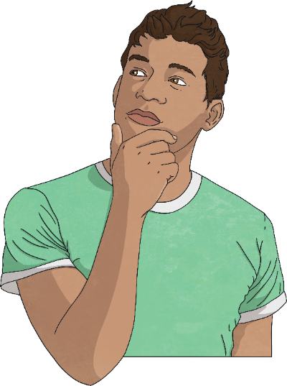
What is Mental Health?
Mental health is all about how we are feeling, the thoughts we are having and how this affects the choices we make and how we behave.
It is also about how able we are to cope with what is happening in our daily lives.
Our mental health can affect how we feel about ourselves and the way we behave towards others.

Slide 4
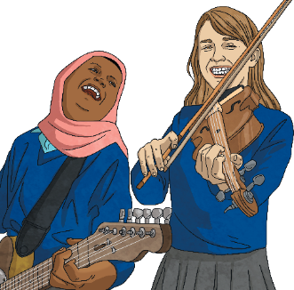
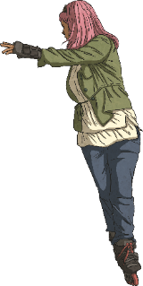
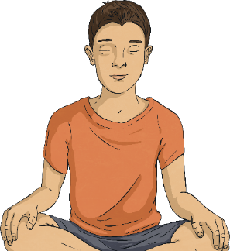
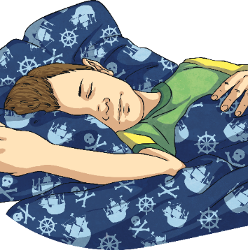
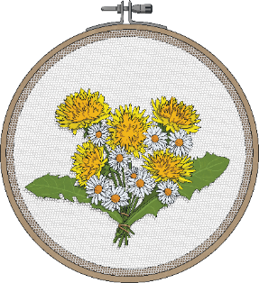
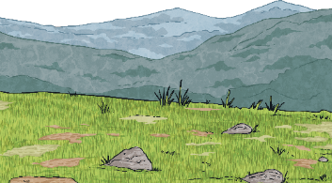
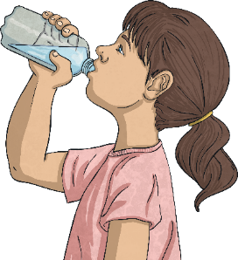
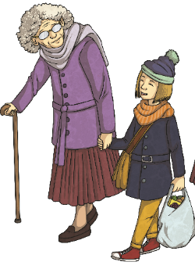
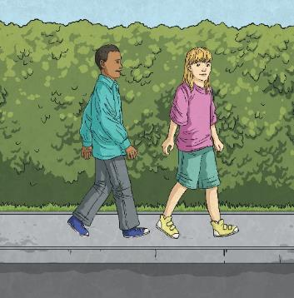
What is Mental Health?
There are lots of ways we can support our mental health and that of others. We can:
spend time with people we care about;
get active;
enjoy some quiet, calm time every day;
get enough sleep;
enjoy hobbies or crafts;
get outside and spend time in nature;
eat a balance of different foods and drink plenty of water;
show kindness to ourselves and others;
do things we enjoy.

Slide 5
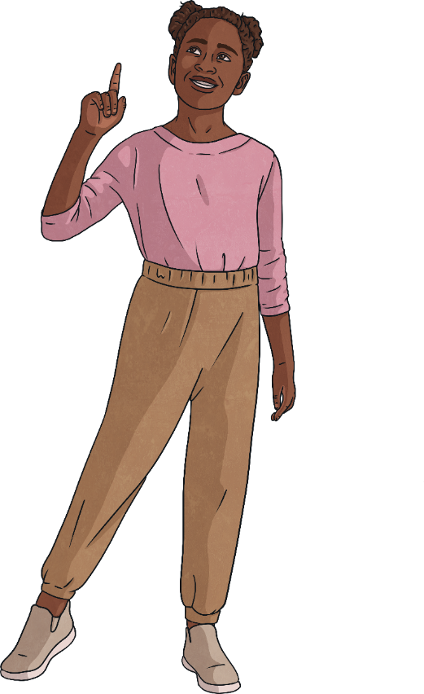

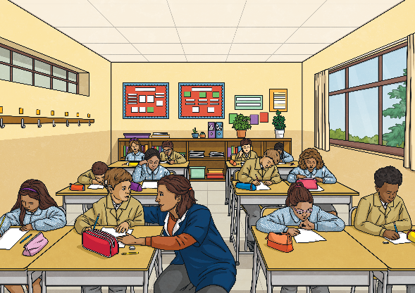
Children’s Mental Health Week
We need to look after our minds as well as our bodies. That’s why learning about and looking after our mental health is just as important as learning about and looking after our physical health.
Children’s Mental Health Week takes place in February every year.
During Children's Mental Health Week, schools and mental health charities work to help support teaching and learning about mental health and wellbeing.

Slide 6
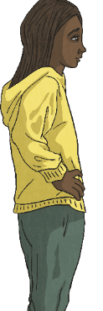
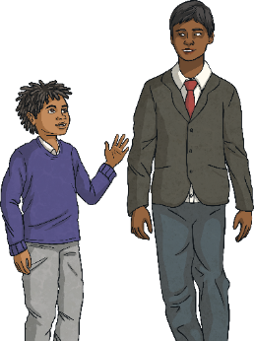
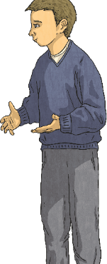
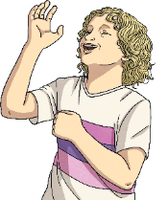
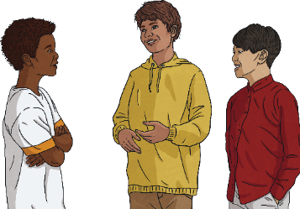
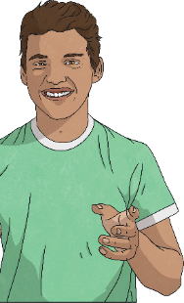
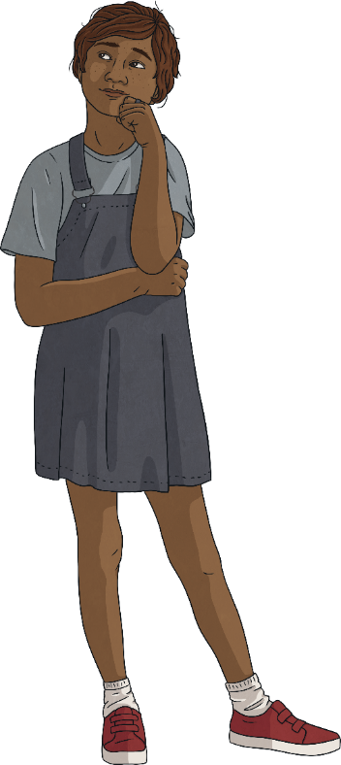
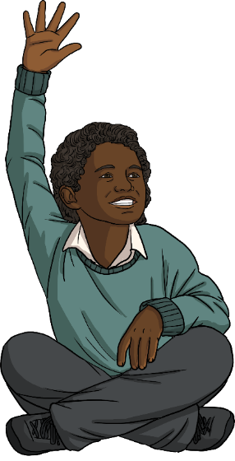
Children’s Mental Health Week
Each year there is a different theme for Children’s Mental Health Week.
What does this mean?
What does this mean?
This year's theme, ‘Know Yourself, Grow Yourself’, highlights the importance of understanding ourselves.
This year, the theme is:
Know Yourself, Grow Yourself
By being self-aware, people can better understand and manage their feelings and emotions, as well as overcome the challenges they face.

Slide 7
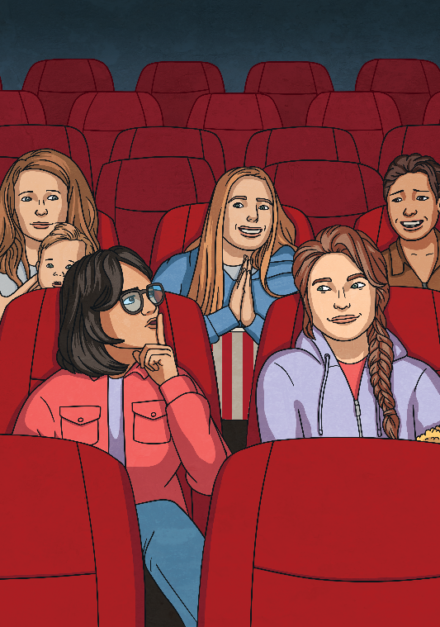

Know Yourself, Grow Yourself
What does it mean to be self-aware?
Self-awareness is our ability to be aware of our thoughts, feelings and behaviours. It includes an understanding of:
things that make us unique;
our likes and dislikes;
what we think and how we feel;
things that make us special;
what is important to us;
our goals and aims;
our strengths and things we need to improve.

Slide 8
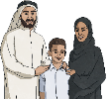
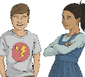

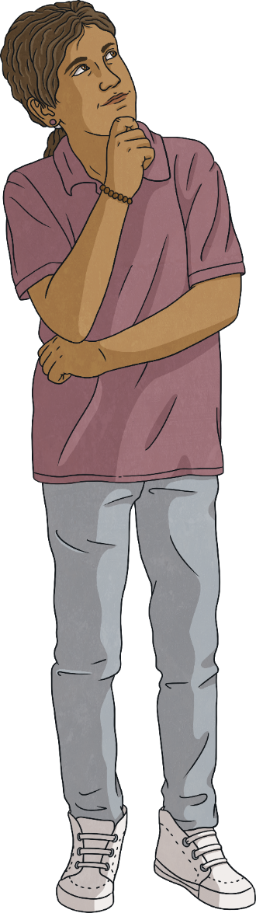
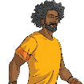

Know Yourself, Grow Yourself
Why is self-awareness important?
Self-awareness can help people to understand, process and regulate emotions.
Self-awareness helps people to cope with challenges and build resilience.
Self-awareness helps people to make informed decisions and develop healthy self-esteem.
Self-awareness helps people to build positive, healthy relationships.
Self-awareness helps people to understand what they are good at and what they need to improve on.

Slide 9
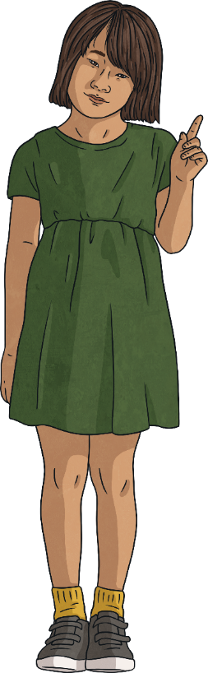
Know Yourself, Grow Yourself
Throughout our daily lives, we all experience a range of different emotions. Some of these emotions will be comfortable while others may be uncomfortable. How we experience different situations and emotions will be unique to us as individuals.
Knowing how we may respond to situations or the different emotions we feel can help us to feel more in control and will help us to be able to overcome uncomfortable feelings.
Part of knowing ourselves includes understanding the different things that help us to feel calm and more comfortable emotions. We can then use these strategies to help us overcome challenges and times when we feel uncomfortable.

Slide 10
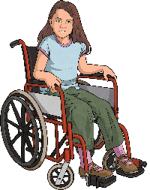
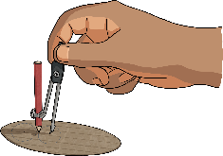

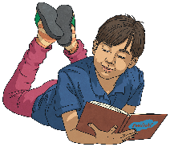
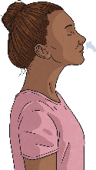
Know Yourself, Grow Yourself
Lyla likes to talk to her brother when she is feeling upset; this helps her to feel better.
Alonso finds that crafting helps him to feel calm.
Lina finds that going for a run helps her to feel better when she is experiencing uncomfortable emotions.
Finn likes to curl up on his beanbag and read a book when he has had a bad day.
Aadya takes deep breaths when she gets angry; this helps her to calm down and feel more in control.

Slide 11
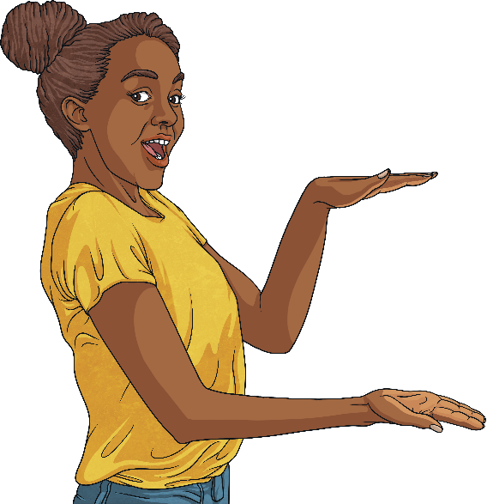
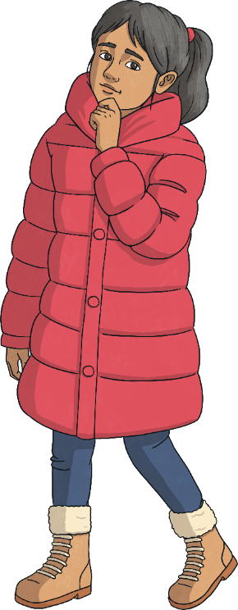
Know Yourself, Grow Yourself
Take some time now to think about yourself.
What are you good at?
What makes you special?
What would you like to get better at?
What things help you to feel comfortable emotions?
Who do you enjoy spending time with?
Take some time this week to think about yourself! Self-awareness helps us learn, grow, overcome challenges and become more resilient.

Slide 12
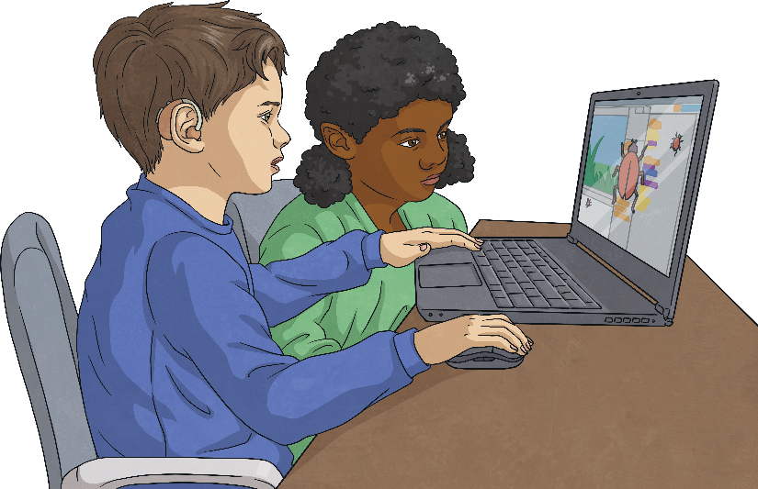
Know Yourself, Grow Yourself
There are many different things people can do to support positive mental health and wellbeing.
As everyone is unique, the things they enjoy and some of the things that help them to feel comfortable emotions will be individual to them.

Slide 13
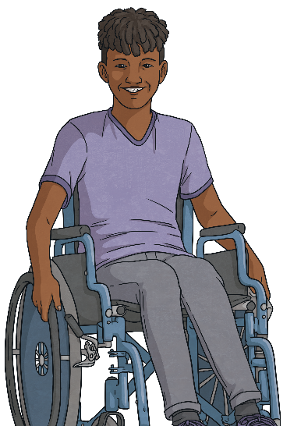
Know Yourself, Grow Yourself
There are many different things people can do to support positive mental health and wellbeing.
Here are some ideas:
Bring nature into our lives.
Spend time with people who are special to us.
Practise mindfulness.
Learn something new or have a hobby.
Be kind to others and to ourselves.
Stay active and look after our bodies.
Make sure we are choosing a balance of activities each day.
Share our thoughts and feelings with someone we trust.
Spend time doing craft activities.
Spend time doing things we enjoy.

Slide 14


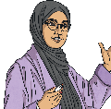
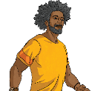
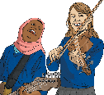
Know Yourself, Grow Yourself
It is important that we all know who we can turn to for help and support when we need it. Self-awareness includes recognising when we may
need to turn to a trusted adult or somebody in
our support network for help.
Support networks are the people around us who are there to help us when we need help; those we can trust, and who will look out for us.
Our support networks are made up of our families, relatives, friends and trusted adults. Different situations may mean we need different members of our support network.
If we are experiencing uncomfortable emotions or facing challenges, our support network can give us the help and support we need.

Slide 15
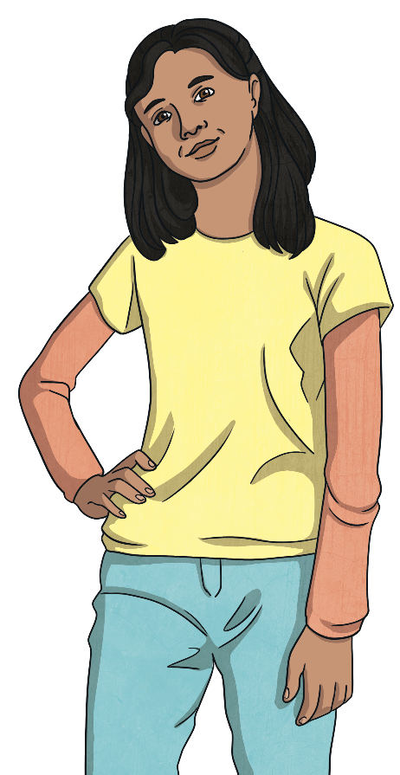
Reflection
Let’s take some time to build self-awareness and better understand things that help us to learn, grow and overcome challenges.

Slide 16
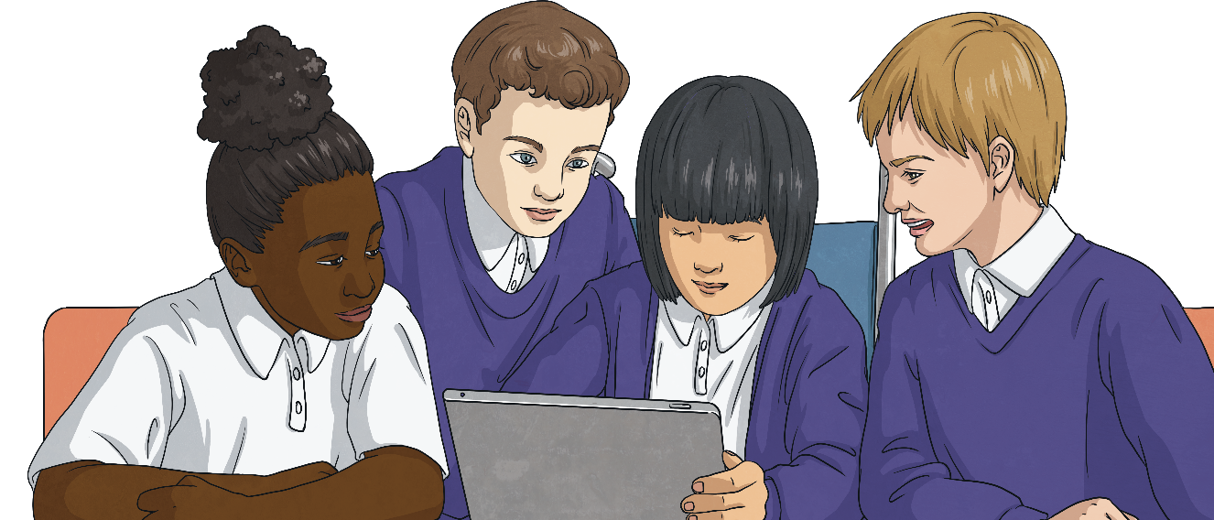
Reflection
Let’s look after our mental health and take care of the mental health of those around us.

